Slide 1






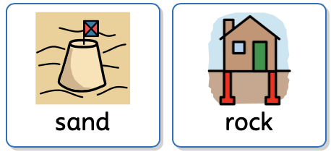
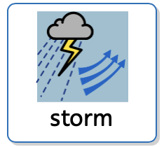
Why? Faith Stories
By Lynn McCann
Why does Jesus tell a story about two builders?

Slide 2
Why does Jesus tell a story about two builders?
There is a Bible story that Jesus told.
It is called the wise and foolish builders.
Jesus told this story to help people understand how to live in a safe and steady way.
In the story, two people build houses.
One house is built on rock.
One house is built on sand.
Then a big storm comes, with rain, wind, and water.
In this story, the house, the rock, the sand and storm are meant to be about people’s lives.

Slide 3







The house is a picture of a person’s life and how they feel inside.
The rock is a picture of things that are solid, true, and dependable.
The Rock means things that help a person feel safe, calm, and supported.
Rock does not move easily.
The sand is a picture of things that are not steady or reliable.
Sand can shift and move.
Sand represents things that make a person feel unsafe, unsteady or unsupported.
The storm is a picture of hard times.
Storms can mean worries, changes, big feelings, confusion, or difficult days.

Slide 4



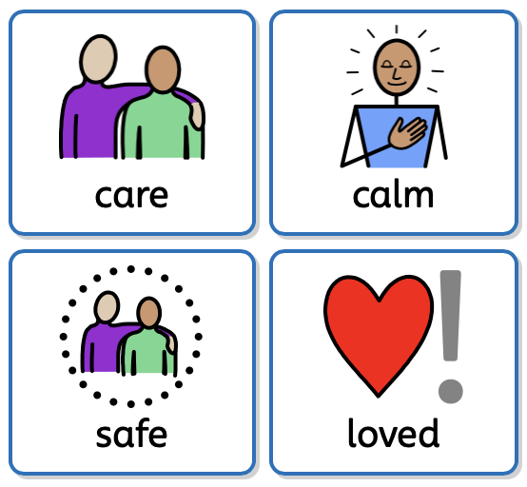
Everyone has storms sometimes, even people who love Jesus.
When the storm comes, the house on the rock stays standing.
When the storm comes, the house on the sand fell down.
Jesus was teaching that he is the strong foundation that help people cope when things feel hard.
This story can help me think about my own rock.
My rock can be my concrete truths, like:
  People who care about me.
  Things that help my body feel calm.
  Clear rules that keep me safe.
  Knowing I am loved by Jesus.

Slide 5




I can also think about my sand.
Sand might be things that make me feel unsafe, overwhelmed, or confused.
Sand can be things I choose to do that are not helping me follow Jesus.
When I remember Jesus’ love is my rock, I can feel safer during my storms.
I am learning how to build my life on things that help me feel secure.
Jesus understands that learning takes time, and that is okay.

